Slide 1

Comsats University Islamabad
Final Year Project Presentation
Department of Electrical and Computer Engineering

Slide 2
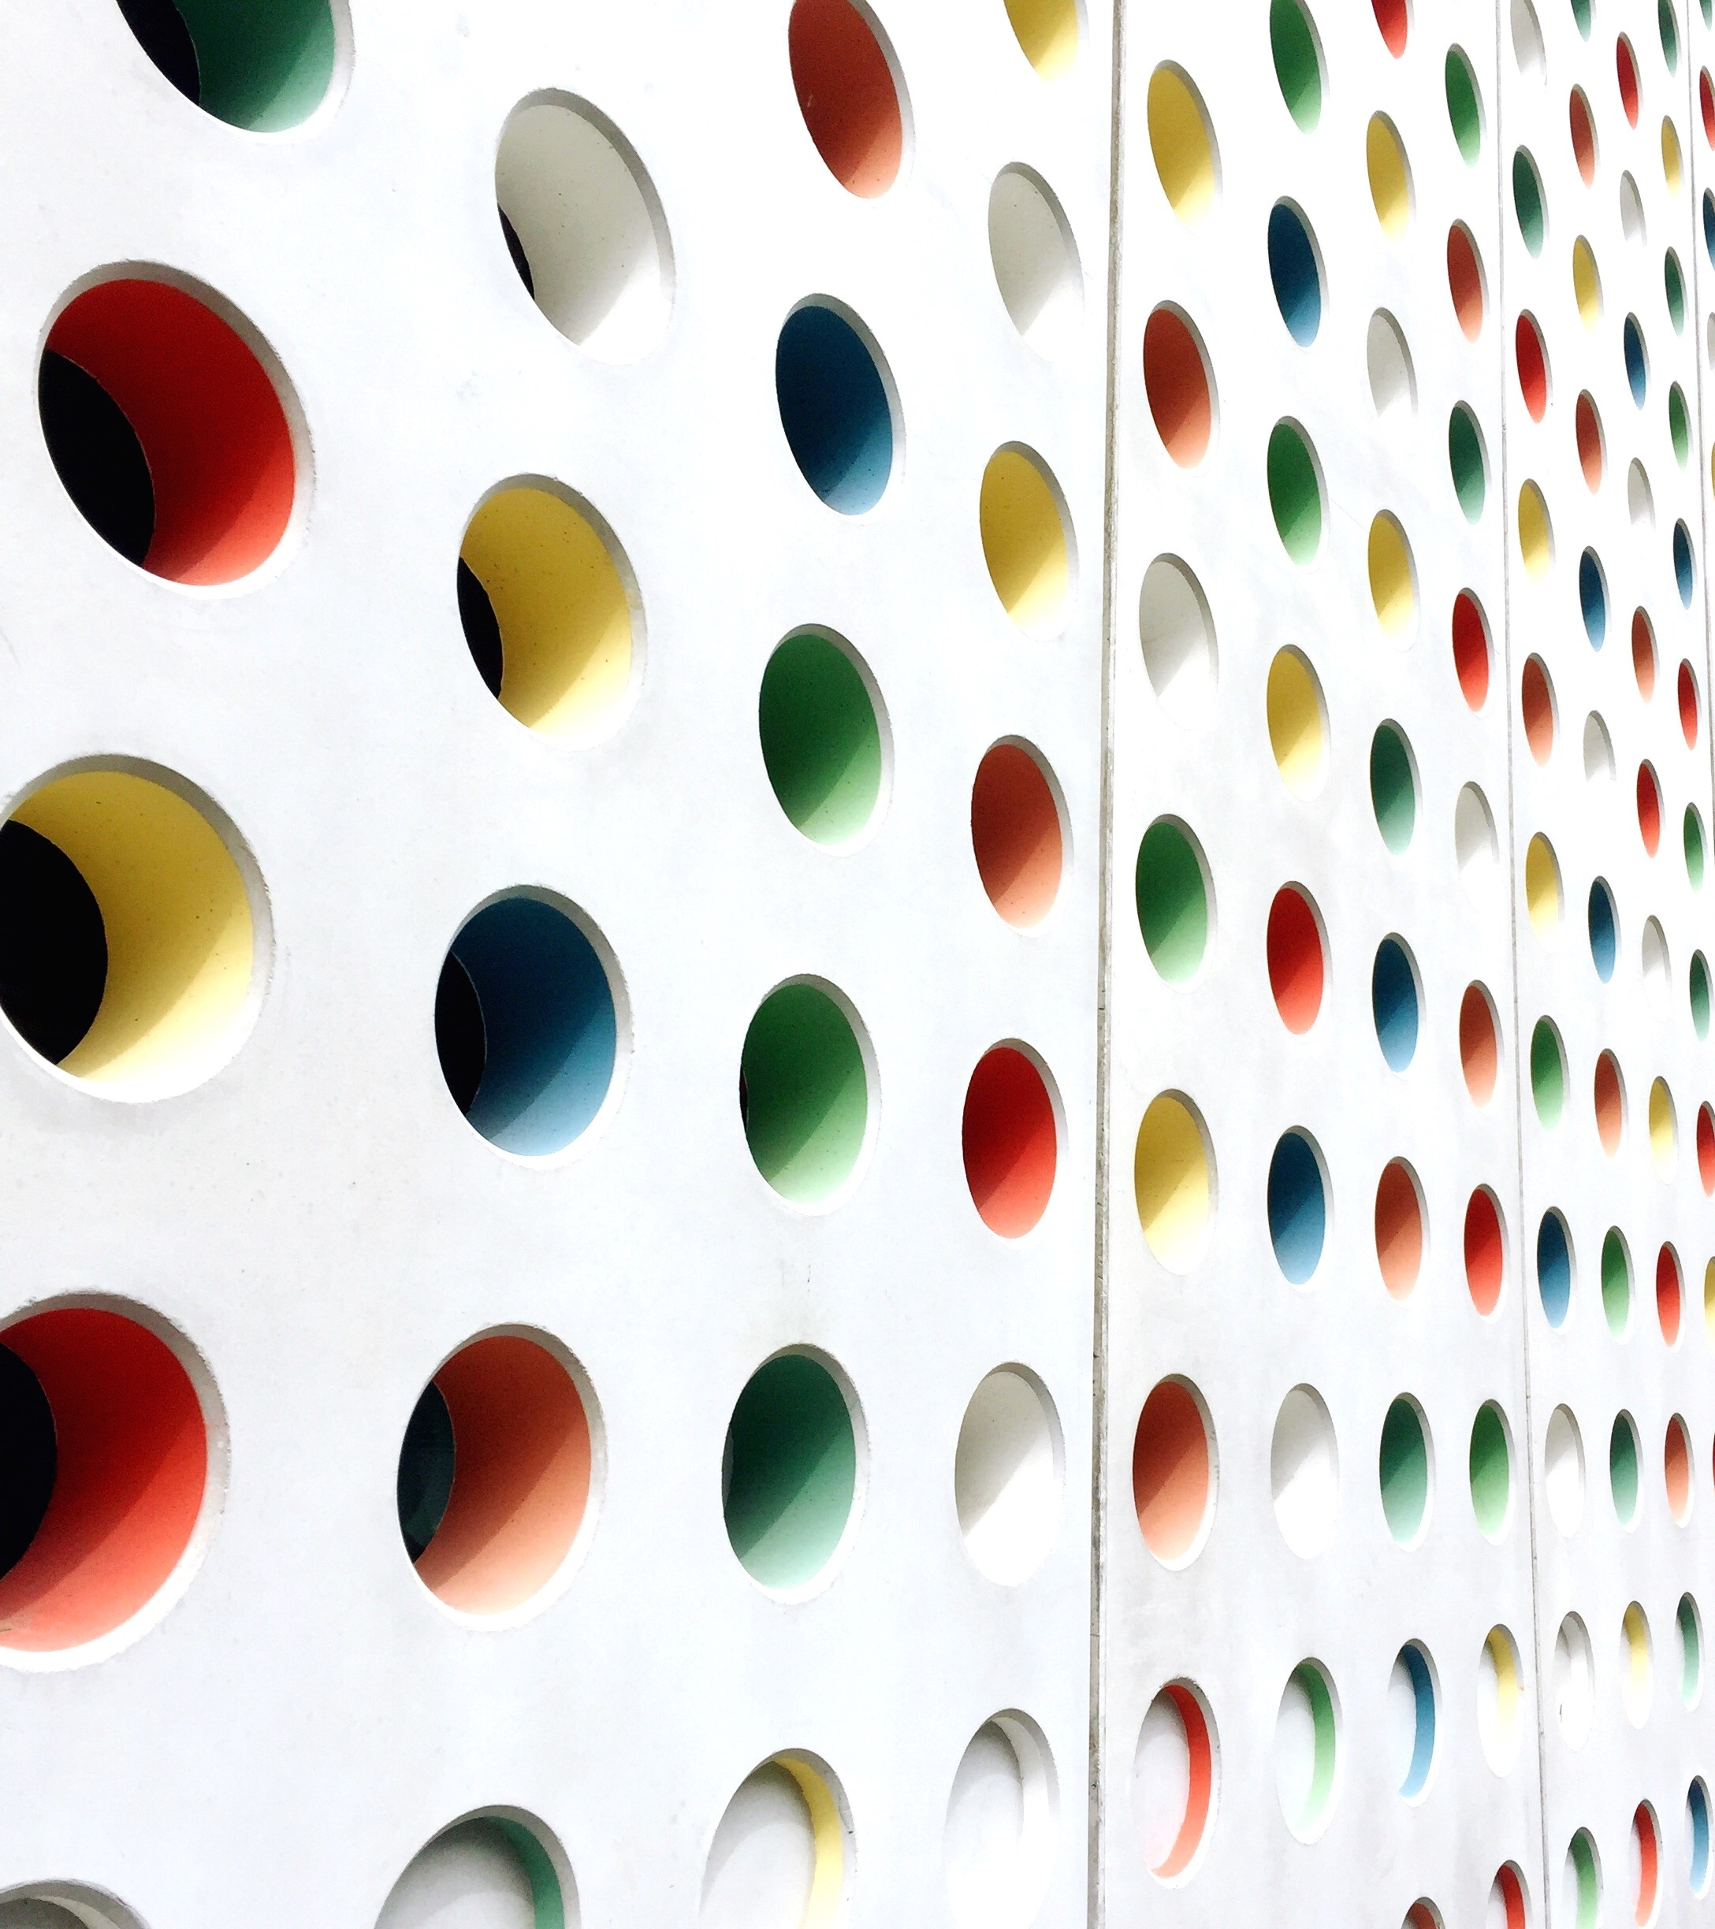
Automated Detection of White Blood Cells (Leukocytes) in Digital Microscopic Image
Supervised By: Dr. Ahsan Khawaja
Presented By:
Waleed Ahmed (FA18-BCE-065)
Muhammad Haris Siddiqui (FA18-BCE-080)
Hasnain Ahmad (FA18-BCE-068)

Slide 3

Problem Statement
Manual identification of white blood cells is a difficult and labor-intensive process
Valuable time of pathologist is wasted by the WBC counting process
Chances for human error remains in the manual identification
Skilled pathologist are required in the manual process, but in remote areas such health professionals and infrastructure are not available

Slide 4
Project Objectives
To develop an automated system that can segment white blood cells in the digital microscopic image from its background
To review already proposed white blood cell segmentation techniques and algorithms
To compare the performance measures (Accuracy, Specificity and Sensitivity) of our technique with previously proposed techniques
To improve performance measures by using modern image pre-processing techniques

Slide 5
Literature Review
This is the research paper on which the
optimizations are based
This is the research paper we Implemented
Type | Method | Year | Accuracy % | Specificity % | Sensitivity %
 | Mohamed and Far (2012) | 2012 | 97.9601 | 99.5129 | 87.4141
Unsupervised | Madhloom et al. | 2015 | 95.7978 | 98.9475 | 96.8925
 | Ghane N, Vard A, Talebi A, Nematollahy | 2017 | 98.4708 | 98.6014 | 93.8764
 | J. Wu, P. Zeng, Y. Zhou and C. Olivier | 2006 | 94.4325 | 97.4907 | 91.3214
 | Hegde, R. B., Prasad, K., Hebbar | 2019 | 99.4764 | 97.0856 | 94.6675

Slide 6
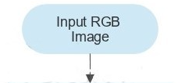
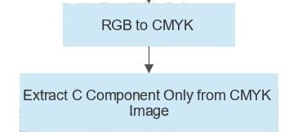

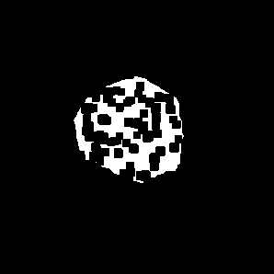

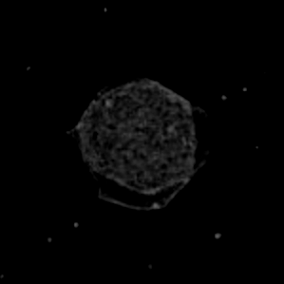
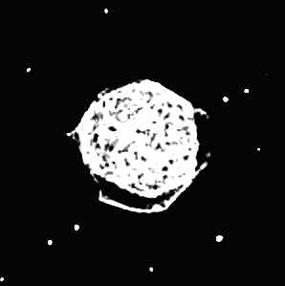
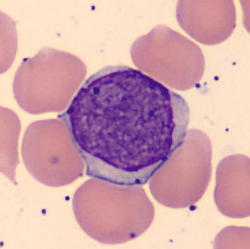
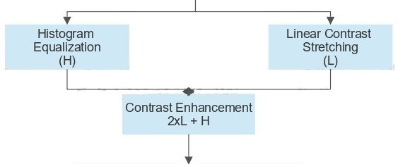
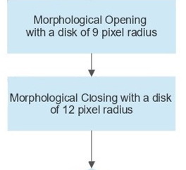
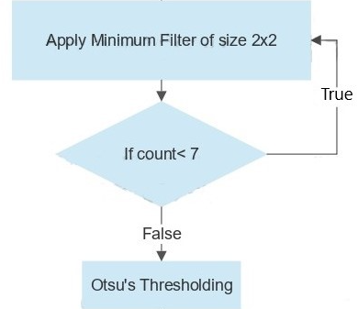
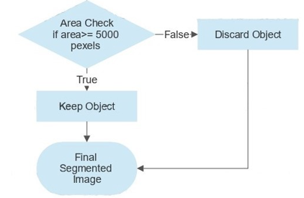
Methodology
Flow Chart

Slide 7
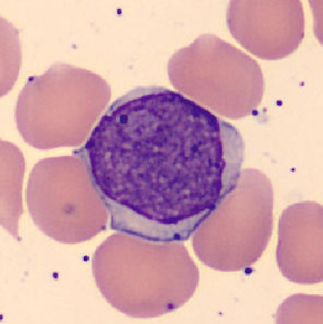
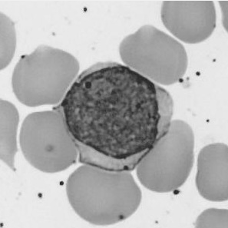
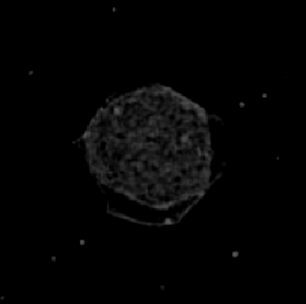
Methodology
Changing Color Domain
Initial Implementation
Optimized Implementation
C component of
CMYK Image
RGB Image
Grayscale Image
RGB Image

Slide 8
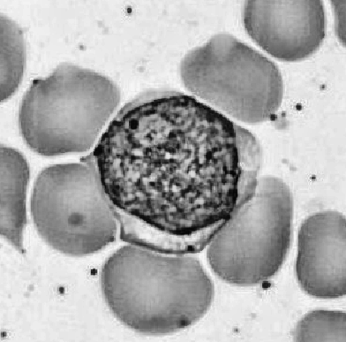
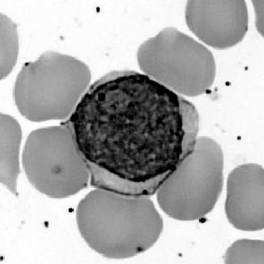
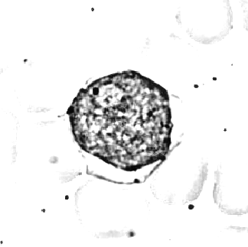
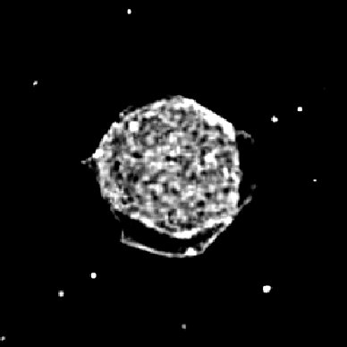
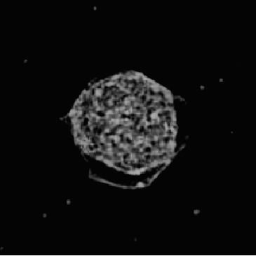
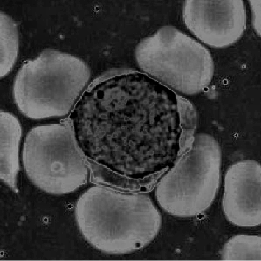
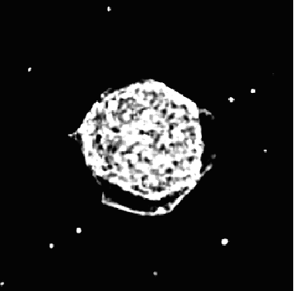
Methodology
Contrast Enhancement
Initial Implementation
Optimized Implementation
Linear Contrast Stretching
Histogram Equalization
Linear Contrast Stretching
Histogram Equalization
R1
2 x
Histogram Equalization
R2
R1
Resulted Image

Slide 9
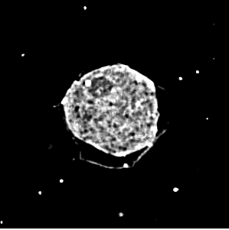
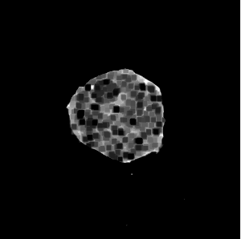

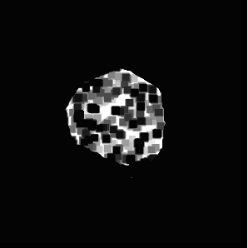
Methodology
Minimum Filtering
Initial Implementation
Using 3x3 Filter with 3 Iterations
Optimized Implementation
Using 2x2 Filter with 7 Iterations
Image before Filtering
Image After Filtering
Image before Filtering
Image After Filtering

Slide 10
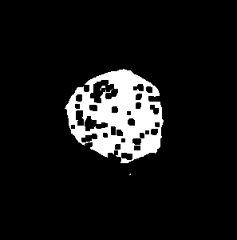




Methodology
Morphological Operations
Initial Implementation
Opening Operation
Optimized Implementation
Opening followed by a closing operation
Binary Image obtained after thresholding
After Morphological
Opening
After Morphological
Closing
Binary Image obtained after thresholding
After Morphological
Opening

Slide 11


Methodology
Area Check
No
Yes
Is not a White Blood Cell
If the Area is greater than 5000 Pixels
Is a White Blood Cell
Image Before Area Check
Image After Area Check

Slide 12
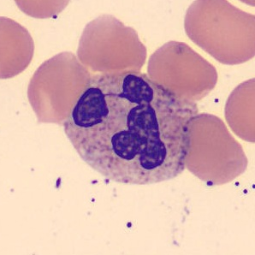
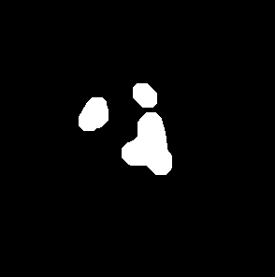
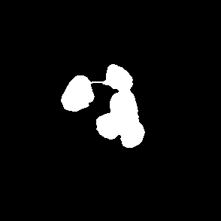
Evaluation Criteria
Original Image
True Positive (TP): Correctly detected foreground pixels.
Resultant Image
Ground Truth Image
True Negative (TN): Correctly detected background pixels.
False Positive (FP): Not Correctly detected foreground pixels.
False Negative (FN): Not Correctly detected background pixels.

Slide 13

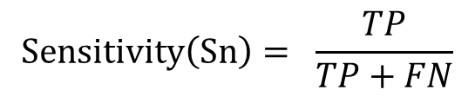
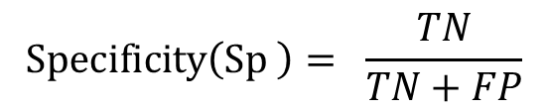
Evaluation Criteria
Performance Measures
Resultant Image
Ground Truth Image
Accuracy :
The ratio of truly detected pixels to the total
number of pixels in the image
Accuracy$\left(Ac\right) = \frac{TP+TN}{TP+TN+FN+FP}$
Specificity :
$$Specificity\left(Sp \right)= \frac{TN}{TN+FP}$$
The ratio of truly detected background pixels
to the total background pixels
The ratio of truly detected foreground pixels
to the total foreground pixels
$$Sensitivity\left(Sn\right)= \frac{TP}{TP+FN}$$
Sensitivity :

Slide 14
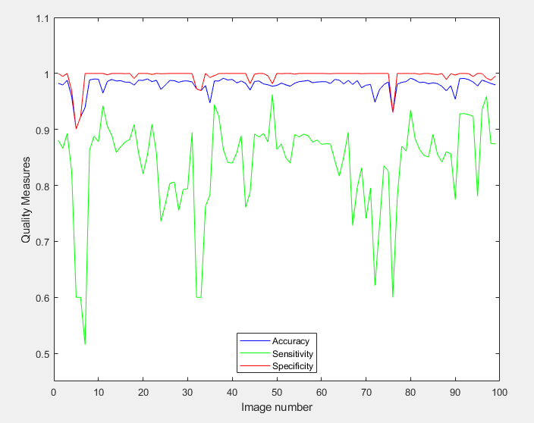
Results & Comparison
Results of Initial Implementation
Performance measures for all 100 images in Graphical Representation
Average Performance Measures
Average Accuracy | Average Sensitivity | Average Specificity
0.979601134 | 0.874141382 | 0.995129388

Slide 15
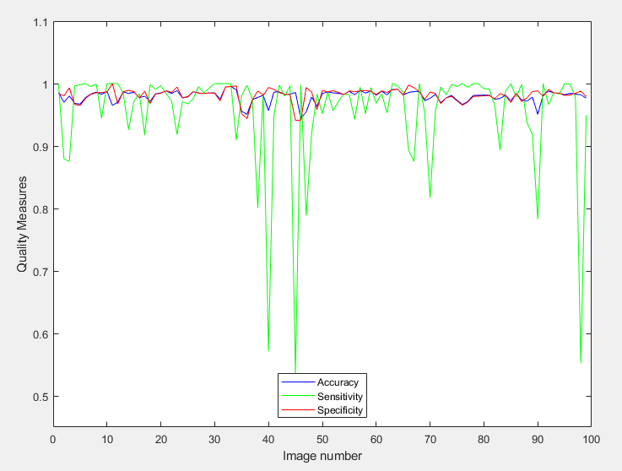
Results & Comparison
RGB Color Domain to CMYK Color Domain Implementation Results
Performance measures for all 100 images in Graphical Representation
Average Performance Measures
Parameters | RGB Color Domain | CMYK Color Domain
Average Accuracy | 0.979601134 | 0.976753175
Average Specificity | 0.995129388 | 0.979220785
Average Sensitivity | 0.874141382 | 0.949528978

Slide 16
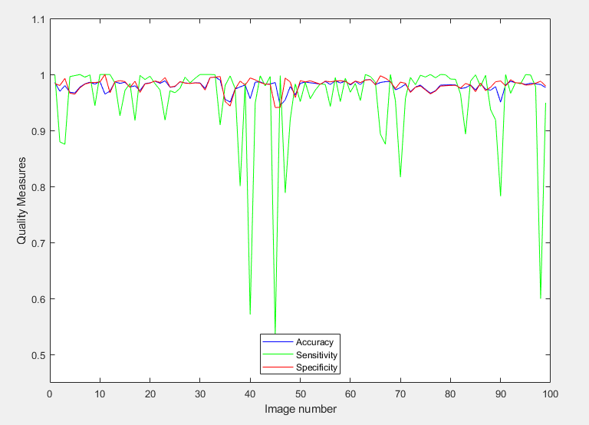
Results & Comparison
3x3 Min Filter to 2x2 Min Filter Implementation Results
Performance measures for all 100 images in Graphical Representation
Average Performance Measures
Parameters | 3x3 Min Filter | 2x2 Min Filter
Average Accuracy | 0.976753175 | 0.975609864
Average Specificity | 0.979220785 | 0.978573548
Average Sensitivity | 0.874141382 | 0.949528978

Slide 17
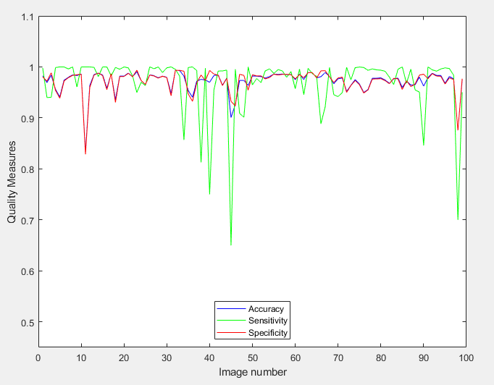
Results & Comparison
Morphological Closing & Morphological Opening Implementation Results
Performance measures for all 100 images in Graphical Representation
Average Performance Measures
Parameters | Morphological Opening | Morphological Opening & Closing
Average Accuracy | 0.975609864 | 0.971635147
Average Specificity | 0.978573548 | 0.972264606
Average Sensitivity | 0.94317967 | 0.970664008

Slide 18
Conclusions
Developed an automated system that can segment white blood cells in the digital microscopic image from its background
The proposed scheme is applied on 100 WBC images and compared with manual segmentation result by three performance measures (Accuracy, Specificity and Sensitivity).
Reviewed already proposed white blood cell segmentation techniques and algorithms
Modern Supervised Learning-based Algorithms can be used in near future for more precise segmentation

Slide 19


